Slide 1
Mobile
Lecture 5 – Jquery
Semester I

Slide 2
Agenda
Startup
Selectors
Modifying the DOM
Events
Ajax

Slide 3
What’s Jquery
JavaScript library
Cross-browser support
Simple selecting of HTML elements
Simple event handling
Simple animation
Ajax calls to server
A lot of plugins available

Slide 4
Jquery file and vsdoc
<script src="https://code.jquery.com/jquery-migrate-3.1.0.js"></script>
https://jquery.com/download/
Using DCN:
<script src="https://ajax.googleapis.com/ajax/libs/jquery/3.4.1/jquery.min.js"></script>
<script src="//code.jquery.com/jquery-migrate-1.2.1.min.js"></script>
Uncompressed version :
http://code.jquery.com/jquery-[version].js
Minified version for release:
http://code.jquery.com/jquery-[version].min.js
IntelliSense :build in since VS2013
Do not use the CDN links as you sometimes don’t have an internet link

Slide 5
Jquery file and vsdoc cont’
<head>
<script src="https://code.jquery.com/jquery-3.0.0.js"></script>
<script src="https://code.jquery.com/jquery-migrate-3.1.0.js"></script>
</head>
Using the script at the end of the body, after the DOM is build
<body>
<div id="a"></div>
<script type="text/javascript">
$('#a').text('nir');
</script>
</body>
$ - the jquery function

Slide 6
$(document).ready
Ready – when the DOM is loaded and ready to use (before the images are loaded)
<head>
<script type="text/javascript" src="scripts/jquery
<script>
$(document).ready(func1); //callback function
function func1() {
$('#a').text('nir');
}
</script>
</head>
Or simpler…
<head>
<title>jqeury</title>
<script type="text/javascript" src="scripts/jquery-1.9.1
<script>
$(document).ready(function () { //anonymous function
$('#a').text('nir');
});
</script>
</head>

Slide 7
Agenda
Startup
Selectors
Modifying the DOM
Events
Ajax

Slide 8
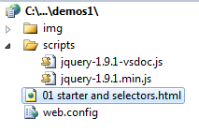
Selectors
Selectors enables you to select one or more html element\tags in order to perform a manipulation on it.
Can be done using JS but not as simple as with Jquery
$(selctorExpression) = jQuery(selctorExpression)

Slide 9
Selecting by Tag Name
alert($('div').text());
…
<div id="firstName">Dexter</div>
<div id="lastName">Morgan </div>
DexterMorgan
Returns a collection of all the divs
.text() : returns the text value of the element

Slide 10
Selecting multiple elements
alert($('div,p,span').text());
…
<div id="firstName">Dexter</div>
<div id="lastName">Morgan</div>
<p>Debra</p>
<p>Morgan</p>
<span>Harry</span>
<span>Morgan</span>
DexterMorganDebraMorganHarryMorgan
Use , to select more than one element. (not necessary by tag name)
Here: all the divs, ps and spans

Slide 11
Selecting Descendants elements
alert($('div p,p span').text());
…
<div id="firstName">
<p>Dexter</p>
</div>
<div id="lastName">Morgan</div>
<p>
<a>
<span>Debra</span>
</a>
</p>
<p>Morgan</p>
<p>
<span>Harry</span>
</p>
<span>Morgan</span>
DexterDebraHarry
$(ancestor descendant) select the descendant of this ancestor. (not necessarily by tag name)
Not necessarily immediate descendant
Here: all the p within a div and all span within a p

Slide 12
.each()
$('div p,p span').each(function () {
alert($(this).text());
});
…
<div id="firstName">
<p>Dexter</p>
</div>
<div id="lastName">Morgan</div>
<p>
<a>
<span>Debra</span>
</a>
</p>
<p>Morgan</p>
<p>
<span>Harry</span>
</p>
<span>Morgan</span>
Dexter
Debra
Harry
Will iterate through all the elements and perform the function on each of them. 3 separate alerts!
this – is the element selected. Here we use it as jquery object to get the .text() function

Slide 13

Selecting by Id
$('#lastName').css('color', 'red');
…
<div id="firstName">
<p>Dexter</p>
</div>
<div id="lastName">Morgan</div>
<p>
<a>
<span>Debra</span>
</a>
</p>
<p>Morgan</p>
<p>
<span>Harry</span>
</p>
<span>Morgan</span>
Change the style
# - Returns the element with the specified ID
The fastest way to find an element!

Slide 14

Selecting start from a specific place
$('p', '#firstName').each(function () {
$(this).css('color', 'yellow');
});
…
<div id="firstName">
<p>Dexter</p>
</div>
<div id="lastName">Morgan</div>
<p>
<a>
<span>Debra</span>
</a>
</p>
<p>Morgan</p>
<p>
<span>Harry</span>
</p>
<span>Morgan</span>
$(‘element1’,’element2’) = $(‘element2 element1’) - Returns element1 within the element2

Slide 15
Selecting by class
$('.names').each(function () {
alert($(this).text());
});
//much more complicated
//not all browser supports
//only HTML5
//dont have intellisense
var namesJS = document.getElementsByClassName('names');
for (var i = 0; i < namesJS.length; i++) {
alert(document.getElementsByClassName('names')[i].innerText);
}
…
<div id="firstName" class="names">
<p>Dexter</p>
</div>
<div id="lastName" class="names">Morgan</div>
<p>
<a><span class="spans">Debra</span> </a>
</p>
<p class="names">Morgan</p>
<p>
<span class="spans">Harry</span>
</p>
<span class="spans">Morgan</span>
Dexter
Morgan
Morgan
Dexter
Morgan
Morgan

Slide 16
Selecting by class cont’
. - Returns the element with the specified class name
You can see how simple and convenient is Jquery comparing to JS!!!
.Length : returns how many elements are in the collection
alert($('div.names').length);
…
…
<div id="firstName" class="names">
<p>Dexter</p>
</div>
<div id="lastName" class="names">Morgan</div>
<p>
<a><span class="spans">Debra</span> </a>
</p>
<p class="names">Morgan</p>
<p>
<span class="spans">Harry</span>
</p>
<span class="spans">Morgan</span>
2

Slide 17
Selecting by attribute
3
alert($('[title]').length);
alert($('div[title]').length);
alert($('div[title="LName"]').length);
…
<div id="firstName" class="names" title="FName">
<p>Dexter</p>
</div>
<div id="lastName" class="names" title="LName">Morgan</div>
<p>
<a><span class="spans">Debra</span> </a>
</p>
<p class="names" title="pt">Morgan</p>
…
2
1
[attribute] - Returns the element with the specified attribute
[attribute=“value”] - Returns the element with the specified attribute=value

Slide 18
Selecting by attribute cont’
alert($('input[type="text"]').length);
…
<p>first name:<input type="text" id="txtFName"/></p>
<p>last name:<input type="text" id="txtLName"/></p>
<p><input type="button" id="btn1" value="push"/></p>
<p><input type="checkbox" id="chk1"/>choose</p>
…
2
Only the textboxes

Slide 19
Selecting by input
6
alert($(':input').length);
alert($(':input[type="text"]').length);
alert($('select').val());
$('textarea').val($('textarea').val() + " is great!");
…
<p>first name:<input type="text" id="txtFName"/></p>
<p>last name:<input type="text" id="txtLName"/></p>
<p><input type="button" id="btn1" value="push"/></p>
<p><input type="checkbox" id="chk1"/>choose</p>
<p><textarea rows="3" cols="10">season 3</textarea></p>
<p><select>
<option value=""></option>
<option value="LaGuerta">LaGuerta</option>
<option value="Batista ">Batista </option>
</select></p>
<p><img src="img/dex.jpg"/></p>
2
LaGuerta
Will add the “is graet!” to the textarea
‘:input’ - returns all the input elements like: text, button, checkbox, radio, select, image, textarea, …
‘:input[type=“value”] ‘- Returns the element with the specified type=value. Value = text\radio\checkbox. But not textarea, img,…
Pay attention that the alerts are fired before the img is shown because the ready() is before the images are loaded to the DOM! This is way only 6 inputs and not 7
Acctually 'input[type="text"]‘ is more efficient than ‘:input[type="text"]‘ because it starts with 4 to filter from and not 6!!

Slide 20
.contains()
alert($('div:contains("Mor")').length);
…
<div id="Div1" >Hello Mor</div>
<div id="firstName" class="names" title="FName">
<p>Dexter</p>
</div>
<div id="lastName" class="names" title="LName">Morgan</div>
…
2
element:contains(string) - Returns the element that contains a certain string in it’s text

Slide 21
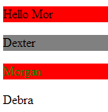
:even \ :odd
$('div:even').each(function () {
$(this).css('background-color', 'red');
});
alert($('div:odd').length);
…
<div id="Div1" >Hello Mor</div>
<div id="firstName" class="names" title="FName">
<p>Dexter</p>
</div>
<div id="lastName" class="names" title="LName">Morgan</div>
…
1
element:even - Returns the even appearance of that elements. 0,2,4…
element:odd - Returns the odd appearance of that elements. 1,3,5,…

Slide 22
:first-child
alert($('span:first-child').length);
…
<p>
<a><span class="spans">Debra</span> </a>
</p>
<p class="names" title="pt">Morgan</p>
<p>
<span class="spans">Harry</span>
<span class="spans">Carry</span>
</p>
<span class="spans">Morgan</span>
2
element:first-child - Returns the element if it is a first child of another element

Slide 23
:eq()
alert($('span:eq(0)').text());
alert($('span:eq(2)').text());
…
<p>
<a><span class="spans">Debra</span> </a>
</p>
<p class="names" title="pt">Morgan</p>
<p>
<span class="spans">Harry</span>
<span class="spans">Carry</span>
</p>
<span class="spans">Morgan</span>
Debra
Carry
element:eq(number) - Returns the element which is number in the order in the whole DOM. Returns only one element.
Starts from 0.
Cant use n variable

Slide 24
:nth-child()
alert($('span:nth-child(1)').text());
alert($('span:nth-child(1)').length);
alert($('span:nth-child(2)').length);
…
<p>
<a><span class="spans">Debra</span> </a>
</p>
<p class="names" title="pt">Morgan</p>
<p>
<span class="spans">Harry</span>
<span class="spans">Carry</span>
</p>
<span class="spans">Morgan</span>
DebraHarry
2
1
element:nth-child(number) - Returns the element which is the nth-child of some parent. Can return more than one element.
Starts from 1.

Slide 25
:nth-child()
$('span:nth-child(2n)').each(function () {
alert($(this).text());
});
$('span:nth-child(2n+1)').each(function () {
alert($(this).text());
});
…
<p>
<a><span class="spans">Debra</span> </a>
</p>
<p class="names" title="pt">Morgan</p>
<p>
<span class="spans">Harry</span>
<span class="spans">Carry</span>
</p>
<span class="spans">Morgan</span>
Carry
Morgan
Debra
Harry
Can use n variable like: 2n, 2n+1, 3n…

Slide 26
^= starts with
2
alert($('div[id^="fi"]').length);
…
<div id="fid" >Start</div>
<div id="Div1" >Hello Mor</div>
<div id="firstName" class="names" title="FName">
<p>Dexter</p>
</div>
<div id="lastName" class="names" title="LName">Morgan</div>
element[attribute^=“value”] - Returns elements the their attribute’s value begins with “value”

Slide 27
$= ends with
alert($('input[id$="1"]').length);
…
<p>first name:<input type="text" id="txtFName"/></p>
<p>last name:<input type="text" id="txtLName"/></p>
<p><input type="button" id="btn1" value="push"/></p>
<p><input type="checkbox" id="chk1"/>choose</p>
2
element[attribute$=“value”] - Returns elements the their attribute’s value ends with “value”

Slide 28
*= contains
alert($('div[id*="Na"]').length);
…
<div id="fid" >Start</div>
<div id="Div1" >Hello Mor</div>
<div id="firstName" class="names" title="FName">
<p>Dexter</p>
</div>
<div id="lastName" class="names" title="LName">Morgan</div>
2
element[attribute*=“value”] - Returns elements the their attribute’s value contains “value”

Slide 29
Agenda
Startup
Selectors
Modifying the DOM
Events
Ajax

Slide 30

The example
<style>
.sportCar
{
color: red;
font-style: italic;
}
.familyCar
{
background-color: Gray;
font-family: @Batang;
}
</style>
…
<div class="sportCar">Ferrari</div>
<div class="sportCar">Bmw</div>
<div class="familyCar">Toyota</div>
<div class="familyCar">Mazda</div>
<label>RESULT:</label><div id="result"></div>

Slide 31

each() cont’
$(document).ready(function () {
$('.sportCar, .familyCar').each(function (index) {
$('#result').html($('#result').html() + "</br>" + index +": "+ $(this).html());
});
});
…
<div class="sportCar">Ferrari</div>
<div class="sportCar">Bmw</div>
<div class="familyCar">Toyota</div>
<div class="familyCar">Mazda</div>
<label>RESULT:</label><div id="result"></div>
Will iterate through all the chosen elements and perform the function on each of them.
this – is the element selected.
Index –the current iteration's index. Starting with 0.
Instead of using this we can use the second parameter - element
$(document).ready(function () {
$('.sportCar, .familyCar').each(function (index, element) {
$('#result').html($('#result').html() + "</br>" + index + ": " + $(element).html());
});
});

Slide 32
each() –efficiency consideration!!!
$(document).ready(function () {
$('.sportCar, .familyCar').each(function (index) {
$('#result').html($('#result').html() + "</br>" + index +": "+ $(this).html());
});
});
Better to cache the $('#result') in order to prevent the searching of it in every loop iteration!
$(document).ready(function () {
var output = $('#result');
$('.sportCar, .familyCar').each(function (index) {
output.html(output.html() + "</br>" + index + ": " + $(this).html());
});
});
Now we update the DOM every iteration so to do better we need to use a local variable and update the DOM at the end just once!
var output = '';
$('.sportCar, .familyCar').each(function (index ) {
output += "</br>" + index + ": " + $(this).html();
});
$('#result').html(output);

Slide 33

Attribute
$('div').each(function () {
this.title = 'Hello';
});
…
<div class="sportCar">Ferrari</div>
<div class="sportCar">Bmw</div>
<div class="familyCar">Toyota</div>
<div class="familyCar">Mazda</div>
<label>RESULT:</label><div id="result"></div>
Here we use the this in order to get to the attribute BUT there is no dynamic (on the $()) attribute, instead we can use the .attr() function as follows (attribute not properties like innerText)
$('div').each(function () {
$(this).attr('title', 'Hello');
});
$(element).attr(‘attribute', ‘value'); //to set
$(element).attr(‘attribute'); //to get

Slide 34

Attribute cont’
We could shorten the last modification because the attr() will work on all the collection selected any way:
$('div').attr('title', 'Hello');
$('div').attr('style', 'color:green');
Multiple modifications are done using JSON
The style is one of the attributes
$('div').attr(
{
title: 'Hello',
style: 'color:green;'
});
JSON object looks like this:
{
property: ’value’,
property: ’value’
}
JSON has also nested object (not here)

Slide 35
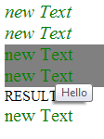
Chaining functions
After calling a jquery function on an element we can chain another function or more than one like this:
$('div').attr('title', 'Hello')
.attr('style', 'color:green')
.css('font-size', '20px')
.text('new Text');

Slide 36

append()
We can append elements using the append() function after a specific element
$('#bmw').append('&nbsp&nbsp&nbsp<span>i8</span>');
...
<div class="sportCar" id="ferrari">Ferrari</div>
<div class="sportCar" id="bmw">Bmw</div>
<div class="familyCar">Toyota</div>
<div class="familyCar">Mazda</div>
<label>RESULT:</label><div id="result"></div>

Slide 37

prepend()
We can prepend elements using the prepend() function before a specific element
$('#ferrari').prepend('<p>Sport Cars</p>');
...
<div class="sportCar" id="ferrari">Ferrari</div>
<div class="sportCar" id="bmw">Bmw</div>
<div class="familyCar">Toyota</div>
<div class="familyCar">Mazda</div>
<label>RESULT:</label><div id="result"></div>

Slide 38

wrap()
We can wrap elements using the wrap() function arround a specific element
$('.sportCar,.familyCar').wrap('<p>');
...
<div class="sportCar" id="ferrari">Ferrari</div>
<div class="sportCar" id="bmw">Bmw</div>
<div class="familyCar">Toyota</div>
<div class="familyCar">Mazda</div>
<label>RESULT:</label><div id="result"></div>

Slide 39

remove()
We can remove elements using the remove() function
$('.sportCar').remove();
...
<div class="sportCar" id="ferrari">Ferrari</div>
<div class="sportCar" id="bmw">Bmw</div>
<div class="familyCar">Toyota</div>
<div class="familyCar">Mazda</div>
<label>RESULT:</label><div id="result"></div>

Slide 40


.css()
The css() function (already saw it) helps us to modify the style.
$('div').css("color", "yellow");
We can use here the JSON object again
$('div').css(
{
'font-size': '20px',
'border': '2px solid black',
'margin': '5px'
}
);

Slide 41

addClass()
We can add a new class or more (using spaces) than just one into an element using the addClass() function
$('.sportCar').addClass('Highlight');
...
<div class="sportCar" id="ferrari">Ferrari</div>
<div class="sportCar" id="bmw">Bmw</div>
<div class="familyCar">Toyota</div>
<div class="familyCar">Mazda</div>
<label>RESULT:</label><div id="result"></div>

Slide 42

removeClass()
We can remove a class or more (using spaces) than just one from an element using the removeClass(‘className’) function
$('.familyCar').removeClass('familyCar');
...
<div class="sportCar" id="ferrari">Ferrari</div>
<div class="sportCar" id="bmw">Bmw</div>
<div class="familyCar">Toyota</div>
<div class="familyCar">Mazda</div>
<label>RESULT:</label><div id="result"></div>
removeClass() without a specific className will remove all the classes of the element

Slide 43

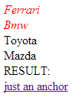
hasClass()
We can ask about a class or more (using spaces) than just if it is a part of an element using the hasClass() function
.Highlight
{
background-color:Yellow;
}
…
$(document).ready(function () {
…
});
function anchorClick(div) {
if ($(div).hasClass('Highlight')) {
$(div).removeClass('Highlight');
}
else {
$(div).addClass('Highlight');
}
}
...
<a href="#" onclick="anchorClick(this)">just an anchor</a>

Slide 44
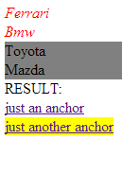
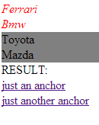
toggleClass()
We can toggle (switch on and off repeatedly) a class or more (using spaces) than just one on an element using the toggleClass() function
.Highlight
{
background-color:Yellow;
}
…
$(document).ready(function () {
…
});
function anchorClickToggle(div) {
$(div).toggleClass('Highlight');
}
...
<a id="a" href="#" onclick="anchorClickToggle(this)">just another anchor</a>

Slide 45
Agenda
Startup
Selectors
Modifying the DOM
Events
Ajax

Slide 46
JavaScript events
In JS we would have to script a different code for IE v.8 and earlier vs. all the other browsers. Jquery is cross platform and much more compact and simple.
<input id="myButton" type="button" value="PUSH" />
<script type="text/javascript">
//JS event
var button = document.getElementById('myButton');
if (document.addEventListener) { //all the other browsers!
button.addEventListener('click', function () { alert('clicked!'); }, false);
}
else { //IE v8 or earlier !
button.attachEvent('onclick', function () { alert('IE v8 or earlier clicked!'); });
}
</script>

Slide 47
Wiring the old fashion
You can wire the events using the markup, but then its more difficult to find it on the page. Wiring all through the jquery makes it easy to find all in the same place!
<input id="myButton" type="button" value="PUSH" onclick="clickFunction()"/>
…
<script type="text/javascript">
function clickFunction() {
alert('click function');
}
</script>

Slide 48

click()
click() – a shortcut for .on( "click", handler )
$(document).ready(function () {
wireEvents();
});
function wireEvents(){
$('#myButton').click(function(){
$('#res').text("Hello " + $('#txtName').val());
});
}
…
<input id="txtName" type="text" />
<input id="myButton" type="button" value="PUSH"/>
<div id="res"></div>

Slide 49

click() cont’
Can be used (normally) as definition for the action taken when we click an element but can be also used to call another click function
$('#myButton2').click(function () {
$('#myButton').click();
$('#res').text($('#res').text() + " through click2");
});
…
<input id="txtName" type="text" />
<input id="myButton" type="button" value="PUSH"/>
<div id="res"></div>
<input id="myButton2" type="button" value="PUSH2"/>

Slide 50
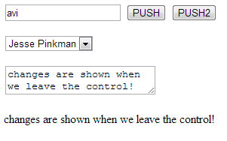
change()
change() – a shortcut for .on( "change", handler )
Works on textbox,textarea and select
$('#selBB').change(function () {
$('#res').text($(this).val());
});
$('#txtName').change(function () {
$('#res').text($(this).val());
});
$('#txtarea').change(function () {
$('#res').text($(this).val());
});
…
<input id="txtName" type="text" />
<input id="myButton" type="button" value="PUSH"/>
<input id="myButton2" type="button" value="PUSH2"/>
<p><select id="selBB">
<option>Jesse Pinkman</option>
<option>Hank Schrader</option>
</select></p>
<p><textarea id="txtarea" rows="2" cols="22"></textarea></p>
<div id="res"></div>

Slide 51
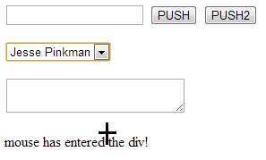
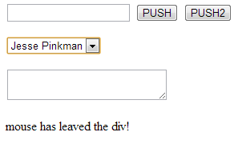
mouseenter\mouseleave\mouseup\mousedown
mouseenter() – a shortcut for .on( "mouseenter", handler )
mouseleave() – a shortcut for .on( "mouseleave", handler )
mouseup() – a shortcut for .on( "mouseup”, handler )
mousedown() – a shortcut for .on( "mousedown", handler )
$('#res').mouseenter(function () {
$('#res').text("mouse has entered the div!");
$(this).css('cursor', 'crosshair');
}).mouseleave(function () {
$('#res').text("mouse has leaved the div!");
});
…
<input id="txtName" type="text" />
<input id="myButton" type="button" value="PUSH"/>
<input id="myButton2" type="button" value="PUSH2"/>
<p><select id="selBB">
<option>Jesse Pinkman</option>
<option>Hank Schrader</option>
</select></p>
<p><textarea id="txtarea" rows="2" cols="22"></textarea></p>
<div id="res"></div>

Slide 52
event args
We can use the event argument to get some information like:
pageX
pageY
The id of the element chosen
$('#res').mouseenter(function () {
$(this).text("mouse has entered the div!");
$(this).css('cursor', 'crosshair');
}).mouseleave(function () {
$(this).text("mouse has leaved the div!");
}).mousedown(function (e) {
$(this).text("mouse was pushed down on id=" + $(e.target).attr('id') +
" in x="+ e.pageX +" and y=" + e.pageY);
});
…
<p><select id="selBB">
<option>Jesse Pinkman</option>
<option>Hank Schrader</option>
</select></p>
<p><textarea id="txtarea" rows="2" cols="22"></textarea></p>
<div id="res"></div>

Slide 53

on() and multiple bindings
We can use the .on function to bind several events together
A bit more efficient that calling the shortcuts – one function call less
This way we can bind an event dynamically
Downside is that we can misspell the string
We can use the event args to manipulate a specific event separately
$('#res').on('mouseenter mouseleave mousedown', function (e) {
$(this).text("mouse has entered or leaved!");
if(e.type=='mousedown')
$(this).text($(this).text() + " mouse was pushed down on id=" + $(e.target).attr('id') +
" in x="+ e.pageX +" and y=" + e.pageY);
});
…
<p><select id="selBB">
<option>Jesse Pinkman</option>
<option>Hank Schrader</option>
</select></p>
<p><textarea id="txtarea" rows="2" cols="22"></textarea></p>
<div id="res"></div>

Slide 54
off()
We can use the .off function to unbind a specific event
$('#res').on('mouseenter mouseleave mousedown', function (e) {
$(this).text("mouse has entered or leaved!");
if(e.type=='mousedown')
$(this).text($(this).text() + " mouse was pushed down on id=" + $(e.target).attr('id') +
" in x="+ e.pageX +" and y=" + e.pageY);
});
$('#myButton').click(function () {
$('#res').off('mousedown');
});
…
<input id="myButton" type="button" value="PUSH"/>
…
<p><select id="selBB">
<option>Jesse Pinkman</option>
<option>Hank Schrader</option>
</select></p>
<p><textarea id="txtarea" rows="2" cols="22"></textarea></p>
<div id="res"></div>
On mousedown
After myButton was clicked and on mousedown

Slide 55
off() cont’
We can use the .off function to unbind all events
$('#res').on('mouseenter mouseleave mousedown', function (e) {
$(this).text("mouse has entered or leaved!");
if(e.type=='mousedown')
$(this).text($(this).text() + " mouse was pushed down on id=" + $(e.target).attr('id') +
" in x="+ e.pageX +" and y=" + e.pageY);
});
$('#myButton').click(function () {
$('#res').text("Hello");
$('#res').off();
});
…
<input id="myButton" type="button" value="PUSH"/>
…
<p><select id="selBB">
<option>Jesse Pinkman</option>
<option>Hank Schrader</option>
</select></p>
<p><textarea id="txtarea" rows="2" cols="22"></textarea></p>
<div id="res"></div>
On mousedown
After myButton was clicked and on mousedown mouseenter or mouseleave

Slide 56
on\off
On and off replace the old:
Bind\unbind
Live\die
Delegate
don't use them any more!

Slide 57


hover()
.hover( mouseInHandler, mouseOutHandler )
<style>
.Highlight
{
background-color: Yellow;
}
</style>
…
$('#res').hover(
function () { //mouseenter
$(this).addClass('Highlight');
},
function () { //mouseleave
$(this).removeClass('Highlight');
}
);
…
<div id="res"></div>

Slide 58
hover() cont’
.hover( mouseInOutHandler)
<style>
.Highlight
{
background-color: Yellow;
}
</style>
…
$('#res').hover(
function () { //mouseInOut
$(this).toggleClass('Highlight');
});
…
<div id="res"></div>

Slide 59
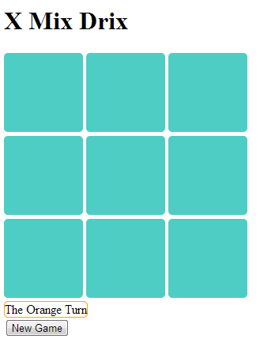
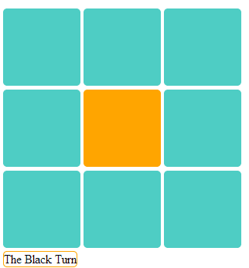
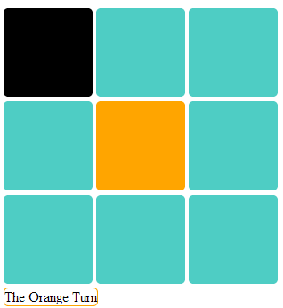
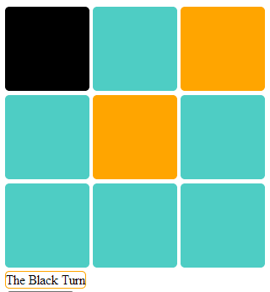
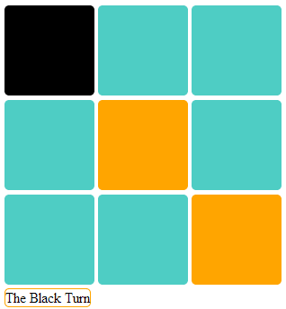
Try it yourself

Slide 60
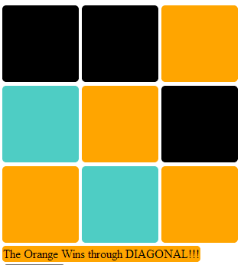
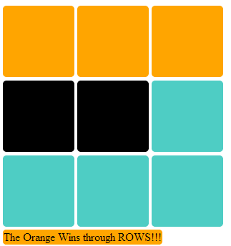
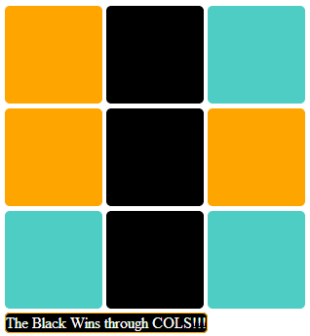
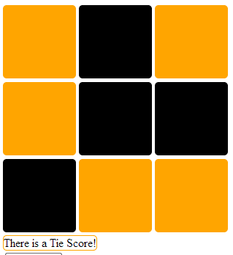
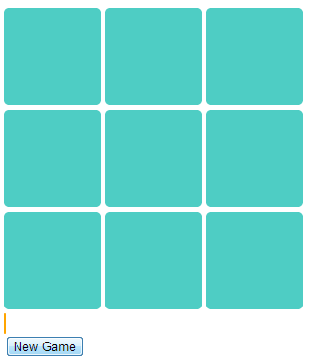
Try it yourself

Slide 61


Drag and Drop
.draggable() – enables the element to be dragged
<link href="styles/jquery-ui%20v1.10.3.css" rel="stylesheet" type="text/css" />
<script type="text/javascript" src="scripts/jquery-1.9.1.min.js"></script>
<script src="scripts/jquery-ui%20v1.10.3.js" type="text/javascript"></script>
…
$('img').draggable({
helper: 'clone' //with this property can be dropped only on a droppable!!!
});
…
<div id="src">
<img src="img/dex.jpg" alt="dex" width="200px"/>
</div>
<div id="target"></div>
2 libraries needed

Slide 62

Drag and Drop
.droppable() – enables the element to be dropped into
<link href="styles/jquery-ui%20v1.10.3.css" rel="stylesheet" type="text/css" />
<script type="text/javascript" src="scripts/jquery-1.9.1.min.js"></script>
<script src="scripts/jquery-ui%20v1.10.3.js" type="text/javascript"></script>
…
$('#target').droppable({
drop: function (event, ui) {
$(this).append(ui.draggable);
}
});
…
<div id="src">
<img src="img/dex.jpg" alt="dex" width="200px"/>
</div>
<div id="target"></div>
On drop…
The element dragged

Slide 63
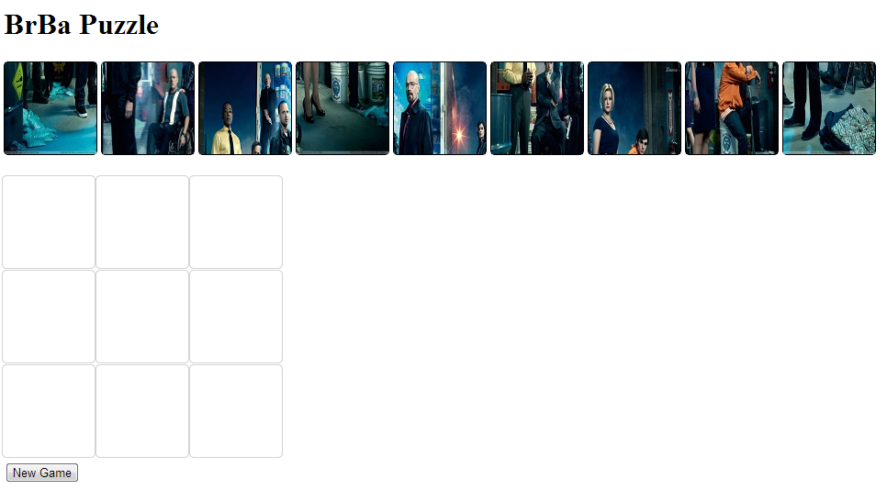
Try it yourself

Slide 64
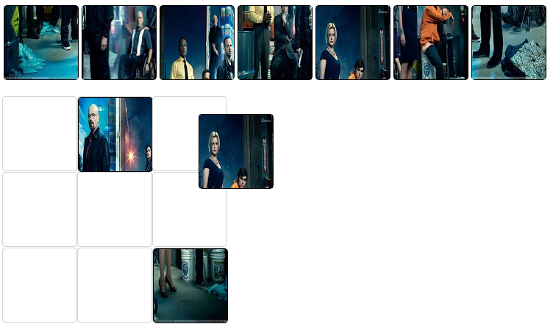
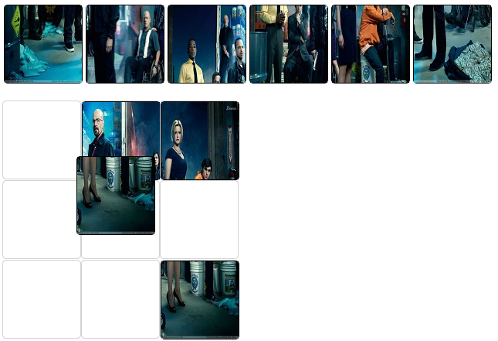
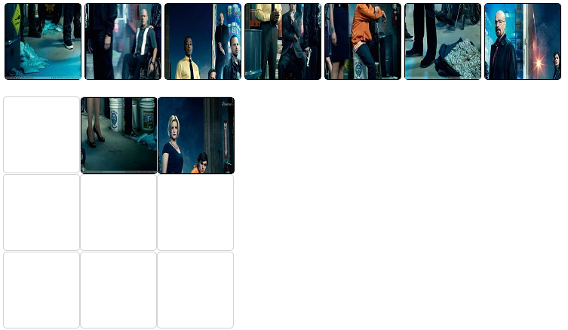

Try it yourself

Slide 65
Agenda
Startup
Selectors
Modifying the DOM
Events
Ajax

Slide 66
Ajax
Ajax - Asynchronous JavaScript and XML
A way to refresh only part of the page (DOM), so it is more efficient than refreshing whole of it.
We will use it to send and receive data from the server.
The data can be of type: JSON, XML, HTML… we will use the JSON format (very efficient)
The server side will be written in Asp.Net C# using the Web Service technique

Slide 67

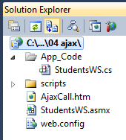
Web Service
A web service is function that can be called from another computer over the internet.
We need to know the url and the functions signature

Slide 68
Web Service cont’
This is just a student class that we would use in the example
class Student
{
static int count=0;
public Student()
{
ID = count;
count++;
Name = "avi" + ID;
Grade = 80 + ID;
}
public int ID { get; set; }
public string Name { get; set; }
public double Grade { get; set; }
}

Slide 69
Web Service cont’
attribute
Could be any name
[WebService(Namespace = "http://nir.org/")]
[WebServiceBinding(ConformsTo = WsiProfiles.BasicProfile1_1)]
// To allow this Web Service to be called from script, using ASP.NET AJAX, uncomment the following line.
[System.Web.Script.Services.ScriptService]
public class StudentsWS : System.Web.Services.WebService {
public StudentsWS () {
//Uncomment the following line if using designed components
//InitializeComponent();
}
[WebMethod]
public string GetStudents(int num)
{
Student[] students = new Student[num];
for (int i = 0; i < num; i++)
{
students[i] = new Student();
}
JavaScriptSerializer serializer = new JavaScriptSerializer();
string jsonString = serializer.Serialize(students);
return jsonString;
}
}
uncomment
JSON

Slide 70
Web config
In order to be able to call and INVOKE the function from another domain (cross domain) let’s say your laptop, we need to add the following to the web.config
<system.web>
<webServices>
<protocols>
<add name="HttpGet"/>
<add name="HttpPost"/>
</protocols>
</webServices>

Slide 71
ajax()
the $.ajax() function has some parameters to set using the JSON object:
url: the url of the Web Service
dataType: the type of the data returned xml, json, script, or html, we use JSON
type: Get\POST, we use POST
data: the data send to the server
contentType: the data type sent to the server, we use "application/json; charset=utf-8"
error: function callback
success:function callback

Slide 72
ajax()
var WebServiceURL = "StudentsWS.asmx"; //the same as above. only with…
$.ajax({
url: WebServiceURL + "/GetStudents",
dataType: "json",
type: "POST", //use only POST!
data: "{'num':'" + num + "' }",
contentType: "application/json; charset=utf-8",
error: function (jqXHR, exception) {
//alert("errornir: " + JSON.stringify(jqXHR)); //all the erro…
alert( formatErrorMessage(jqXHR, exception));
},
success: function (data) {
var str = "";
studentsObj = JSON.parse(data.d); //or data["d"]
for (var i = 0; i < studentsObj.length; i++) {
str += studentsObj[i].ID + "<span class='space'></span>“…
}
$("#studentsTable").html(str);
}
});

Slide 73
ajax() cont’
function formatErrorMessage(jqXHR, exception) {
if (jqXHR.status === 0) {
return ('Not connected.\nPlease verify your network connection.');
} else if (jqXHR.status == 404) {
return ('The requested page not found. [404]');
} else if (jqXHR.status == 500) {
return ('Internal Server Error [500].');
} else if (exception === 'parsererror') {
return ('Requested JSON parse failed.');
} else if (exception === 'timeout') {
return ('Time out error.');
} else if (exception === 'abort') {
return ('Ajax request aborted.');
} else {
return ('Uncaught Error.\n' + jqXHR.responseText);
}
}

Slide 74
Ajax
The code we saw here will only work localhost
In order to use it on other machine, cross domain we need to use the JSONP (JSON with padding) technique. (a bit complicated)
Luckily, we wont need to do anything while using the PhoneGap Build. Because it will do everything for us even with the code we saw here!

Slide 75
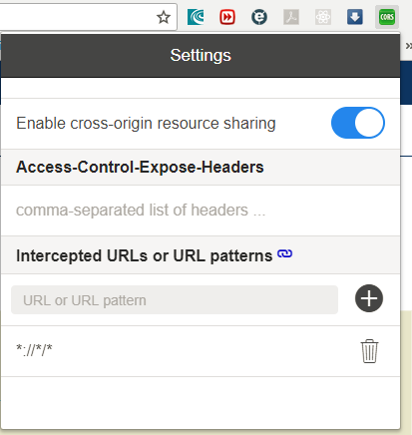
Add extension or add to web.config!!!
<configuration>
<system.webServer>
<httpProtocol>
<customHeaders>
<add name="Access-Control-Allow-Headers" value="accept, content-type" />
<add name="Access-Control-Allow-Origin" value="*" />
<add name="Access-Control-Allow-Methods" value="POST, GET, OPTIONS" />
</customHeaders>
</httpProtocol>
</system.webServer>

